Slide 1

SIIM-FISABIO-RSNA COVID-19 Detection Using chest radiographs
—Data Science Capstone Project Presentation
Shixin Li
07/03/2021

Slide 2
Contents:
Problem Statement
Data Wrangling
Exploratory Data Analysis
Data Pre-processing
Modeling
Conclusion

Slide 3
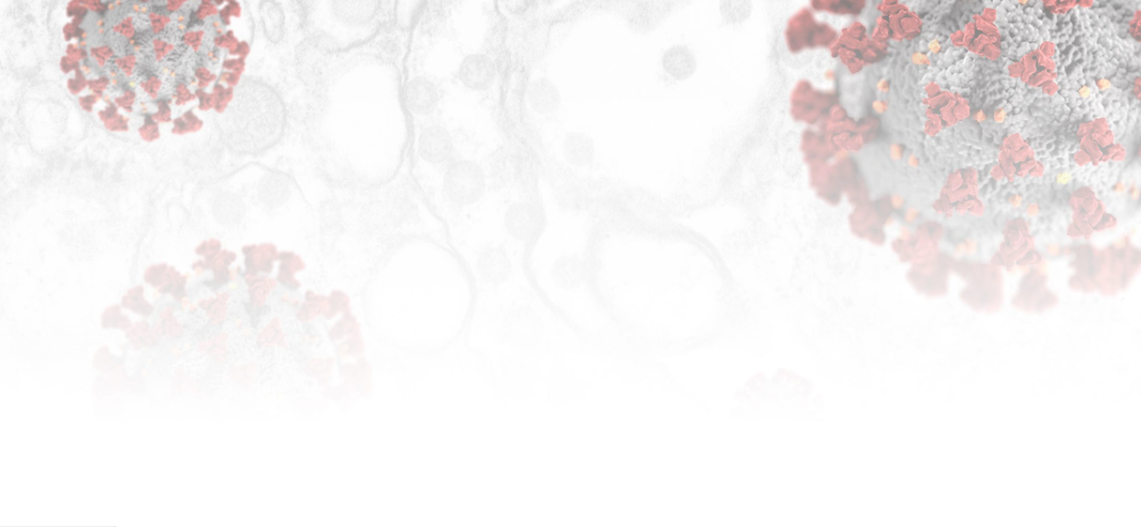
Problem Statement

Slide 4

About this Project
What?
Covid-19 chest radiographs identification using AI
Why?
Help radiologists to diagnose millions of COVID-19 patients more confidently and quickly
How?
To develop the supervised deep learning model to classify the image data

Slide 5
About this project
4. Source of the Data
The Foundation for the Promotion of Health and Biomedical Research of Valencia Region(FISABIO), whose primary purpose is to encourage, to promote and to develop scientific and technical health and biomedical research in Valencia Region
5. Criteria of Project Success
Accuracy >= 90%
F1-Score >= 0.80

Slide 6
Data Wrangling

Slide 7
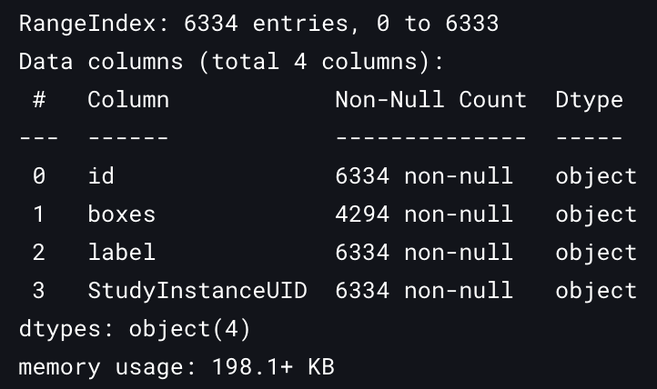
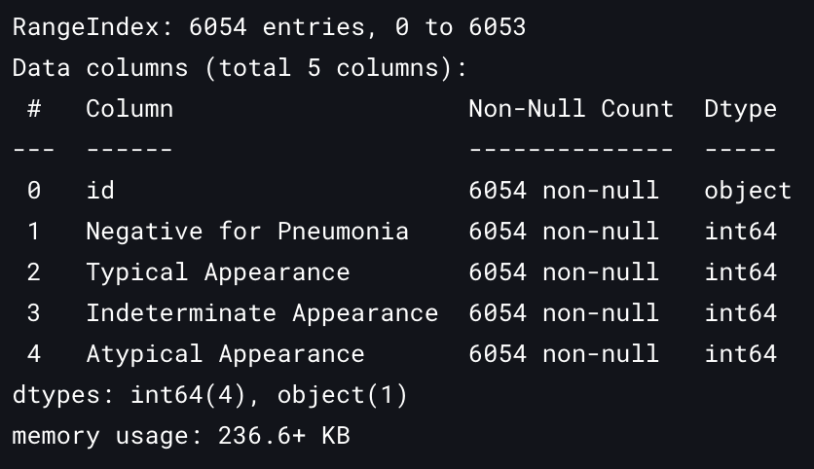
Data Information
Three Data Sets:
Image Data Set: including 6334 one channel chest radiographs in DCM format
train_image_level.csv
train_study_level.csv
Relationship between the data sets:
StudyInstanceUID are corresponding to id in train_study_level.csv
Image names are corresponding to the id in train_image_leve.csv
Missing Value: there are 2040 missing values in column ‘boxes’ in train_image_level.csv, but we don’t need to care about it in this project.

Slide 8
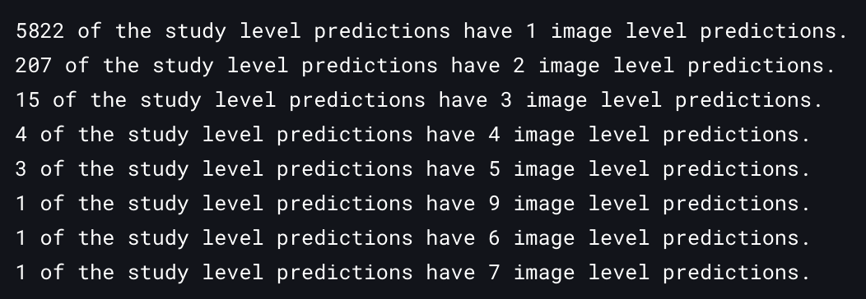
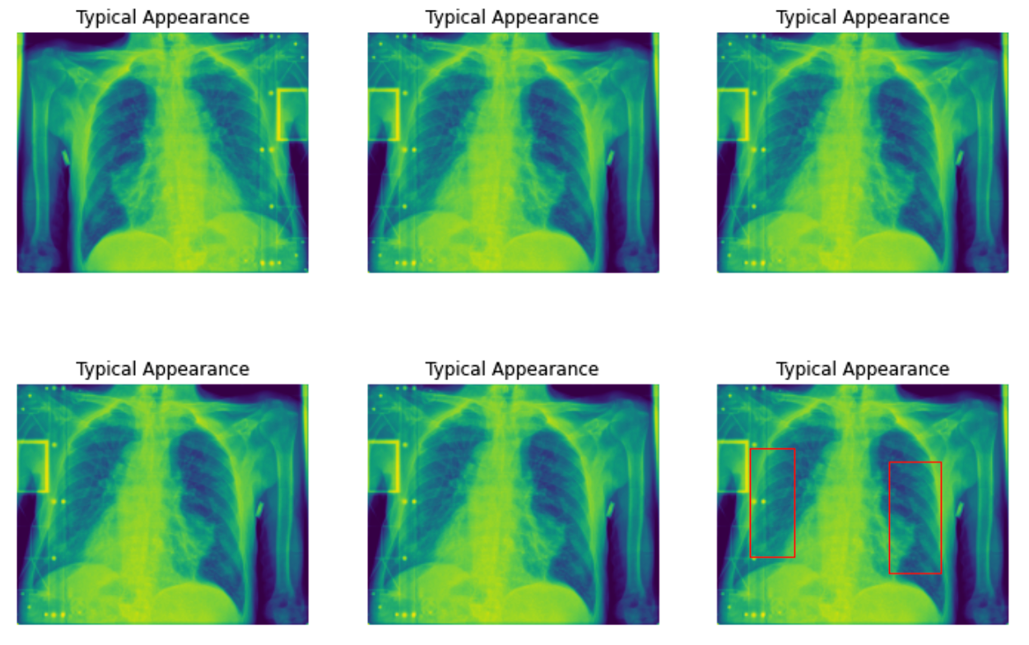
Data Cleaning
Some study level predictions have multiple image level predictions
In the same study level prediction with more than one image level, the images are the same
(see the figure on the right)
remove the duplicated images
After removing the images, we have 6054 images left, the same as the number of study level observations.

Slide 9
Exploratory Data Analysis

Slide 10
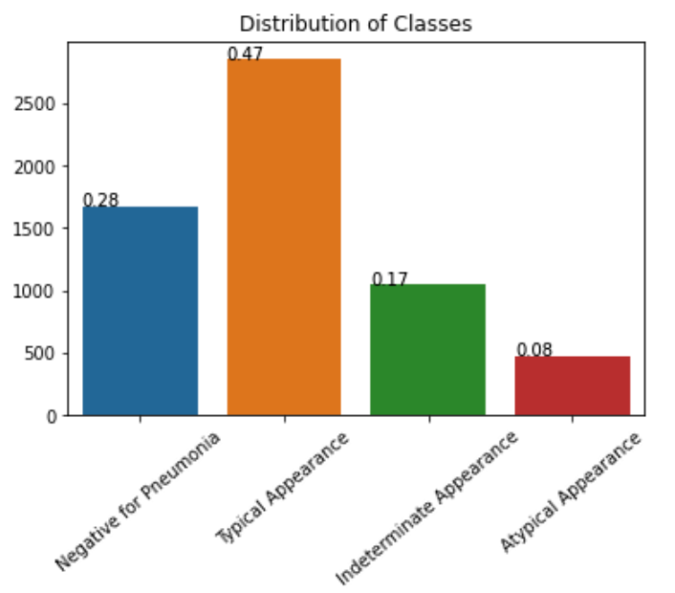
EDA
There 4 classes images:
Typical Appearance: Multifocal bilateral, peripheral opacities with rounded morphology, lower lung–predominant distribution
Indeterminate Appearance: Absence of typical findings AND unilateral, central or upper lung predominant distribution
Atypical Appearance: Pneumothorax, pleural effusion, pulmonary edema, lobar consolidation, solitary lung nodule or mass, diffuse tiny nodules, cavity
Negative for Pneumonia: No lung opacities
2. Class Distribution
Class Imbalance

Slide 11
Data Pre-processing

Slide 12
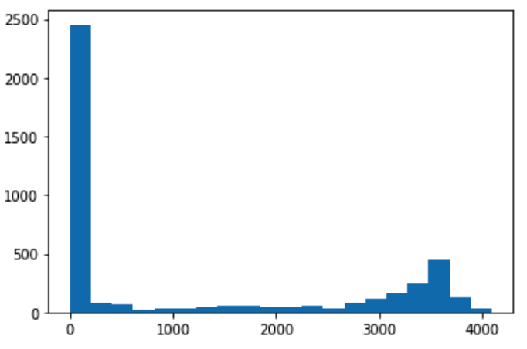
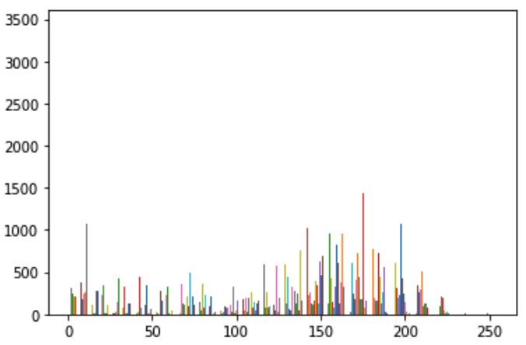
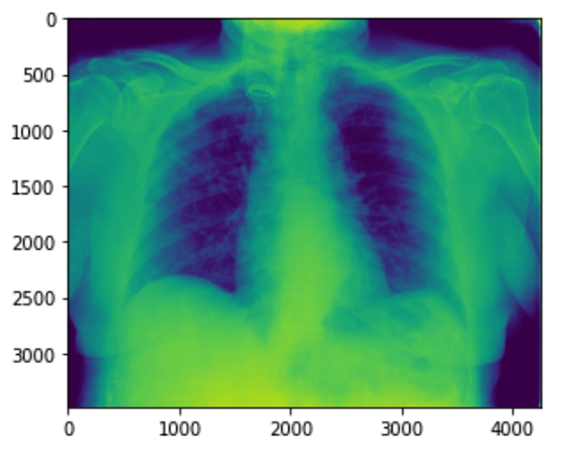
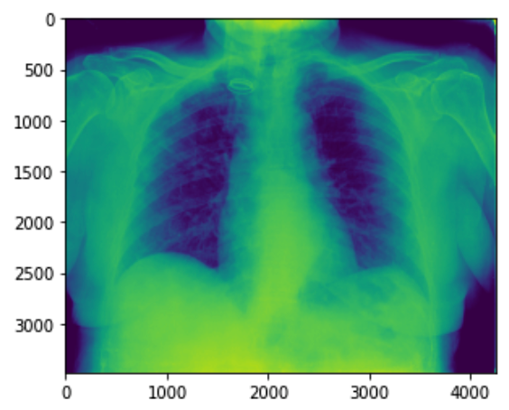
Image Data Pre-processing
Rescale the pixel values to range 0-255
The pixel values of the original images are in a large range, and ranges are different in different images. Rescaling the images can remove some random noise in different images.
Rescale
Transform the image format from DCM to PNG
Save them as PNG can save a lot of memory and easier for later use. The sample image on the left is rescaled and saved as PNG
DCM to PNG

Slide 13
Image Data Generating
Image Data Splitting
Split the data set into training and validation set in ratio 0.8 and 0.2
Image augmentation
Image rotation, horizontal flip, width shift, height shift, shear, zoom in
Image resizing and rescaling
Resize the images from different sizes into 224*224
Rescale the pixel values in range [-1,-1] or [0-1] base on models
Batch size = 64

Slide 14
Modeling

Slide 15
Models & Metric
Supervised deep learning models:
Vgg16 without pretrained weights;
Vgg16 with pretrained weights;
Resnet50 without pretrained weights
Then, add two fully connected layers at the end of each models with normalization and dropout.
Metric for evaluating the models:
Use Area Under the Receiver Operating Characteristics(ROC-ACU) score as the metric to select(or save) the best model during training
Use f1-score as the metric to select the best model from the three different models

Slide 16
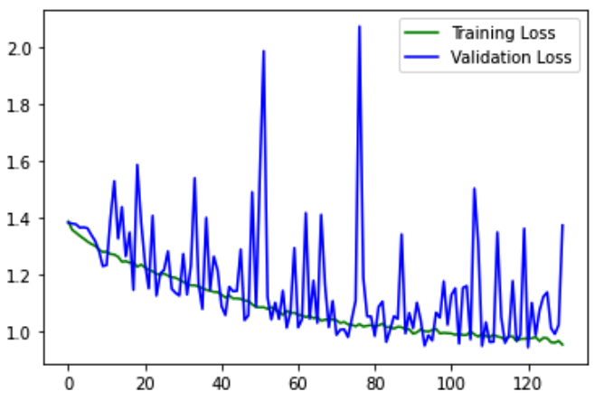
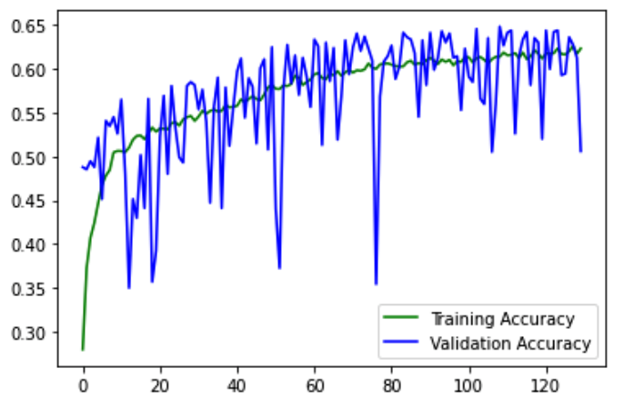
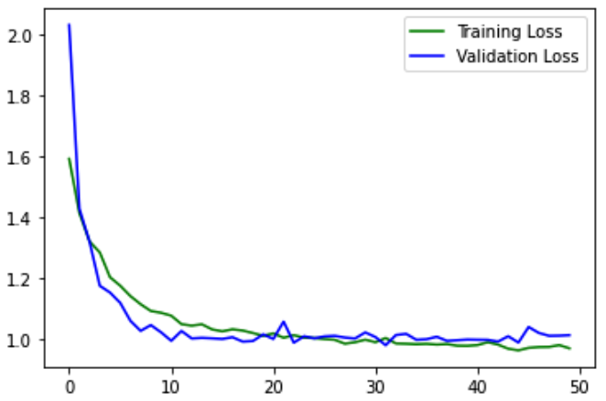
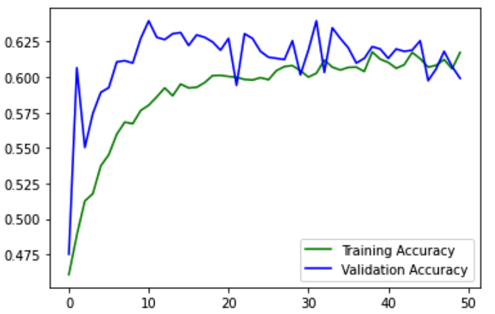
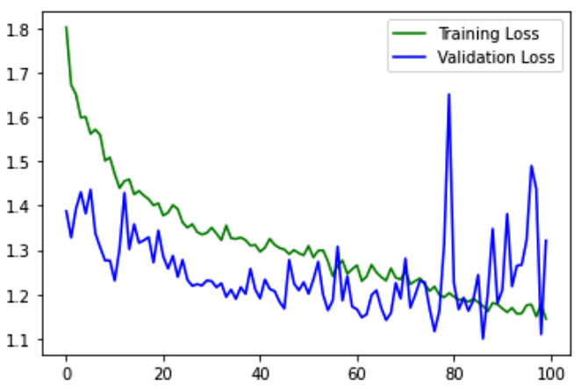
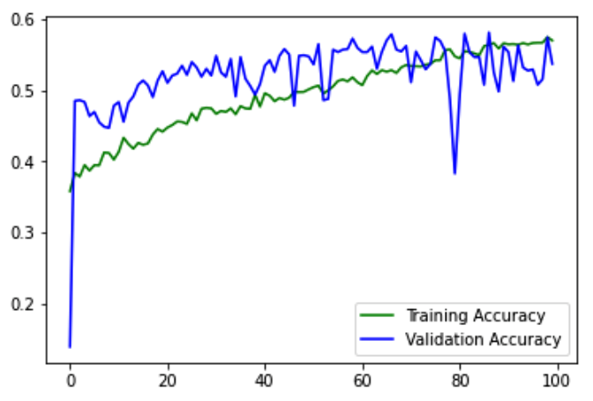
Model Training
Non pretrained Vgg16, lr = 1e-5
Validation loss and accuracy are very unstable
Highest accuracy = 65%
Starts overfitting about epoch=90
2. Pretrained Vgg16, lr = 5e-4
Validation loss and accuracy are more stable
Highest accuracy = 64%
Validation loss reach the lowest point at epoch=32
3. Non pretrained Resnet50, lr = 3e-5
Validation loss and accuracy more stable than Non pretrained Vgg16
Highest accuracy = 58%
Starts overfitting about epoch=75

Slide 17
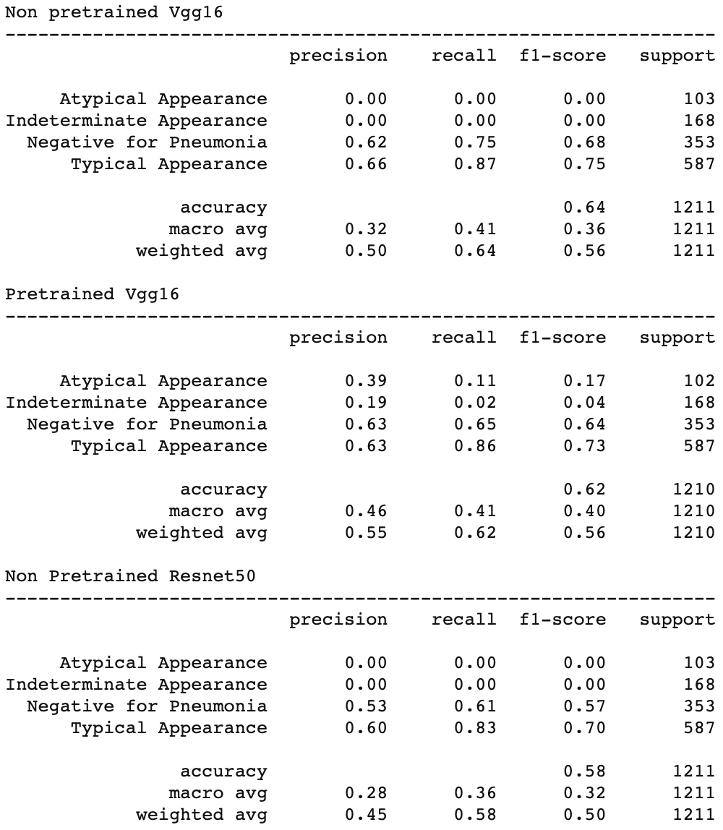
Model Selection
Testing results from each model with best weights:
All models cannot detect class ‘Atypical Appearance’ and ‘Indeterminate Appearance’ well. Non pretrained Vgg16 and non pretrained Resnet can not detect any of them
Pretrained Vgg16 model has the highest average f1-score(macro avg), which is 0.40, and its accuracy is 62%
Non pretrained Vgg16 model has the highest accuracy, which is 64%
Because of class imbalance, f1-score will be the main metric of this project. Therefore, the Pretrained Vgg16 model will be the the best one for these image data set.

Slide 18
Conclusion

Slide 19
Conclusion
The best model for this chest radiograph set is Vgg16 with the pretrained weights
Vgg16 with the pretrained weights got a 62% accuracy and 0.40 f1-score, which are too far off from the criteria of project success(Accuracy>=90%, f1-score>=0.80)
The reason for failure may be because of the lack of image data or the images in different classes are too similar to each other, but we need further research for these guesses.
For further research, the data provider Foundation for the Promotion of Health and Biomedical Research of Valencia Region(FISABIO) should provide more image data, specially the images in classes ‘Atypical Appearance’ and ‘Indeterminate Appearance’

Slide 20
The End!!!!
Thank you for watching!!!!

